Slide 1
Geographical origin of music
STA 9890 project
Group 24：Sili Wei

Slide 2
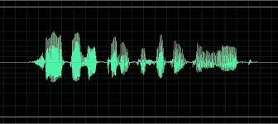
Data description
N=1059
P=68
All numeric predictors
response variable: latitude and longitude of the capital of the country
Predictors: feature extracted from the wave file

Slide 3
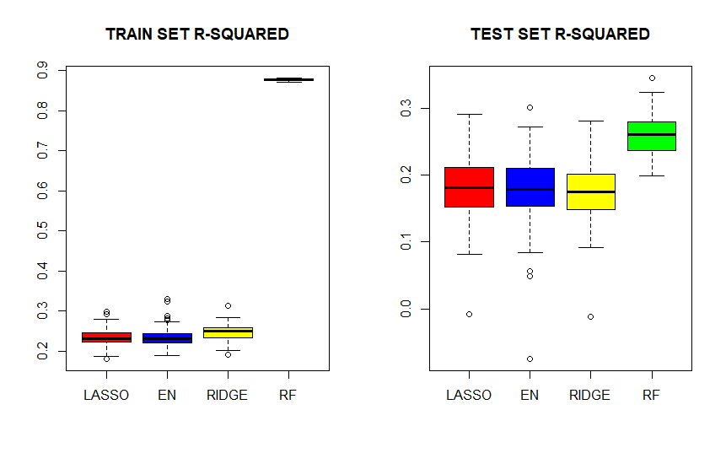
R-squared

Slide 4
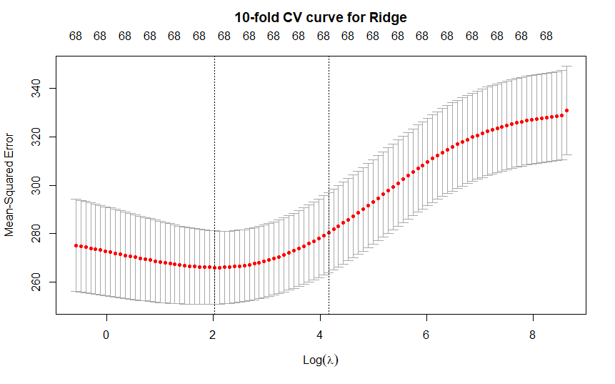
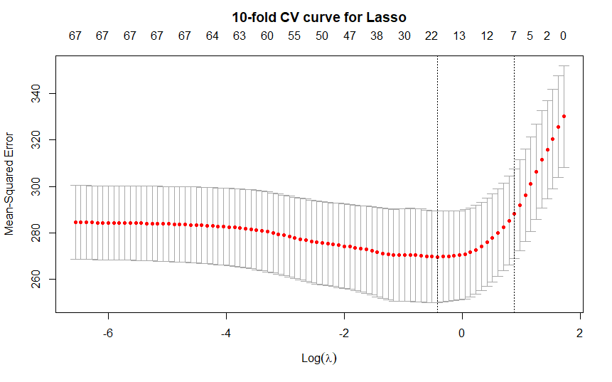
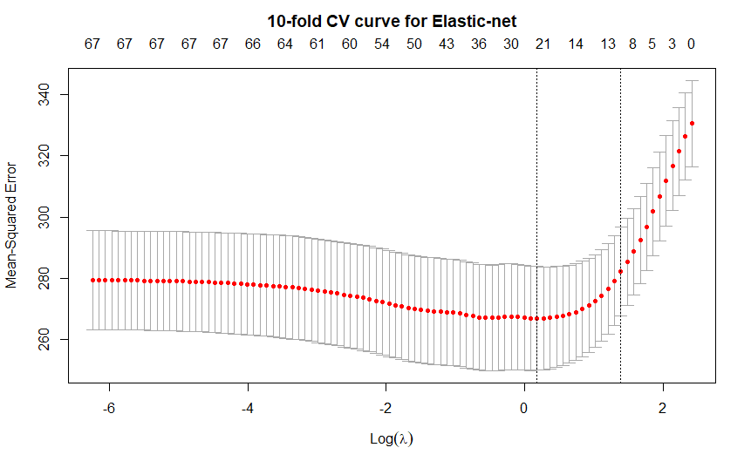
10-fold CV curves
Lasso:0.16s
Elastic-net:0.44s
Ridge:0.41s

Slide 5
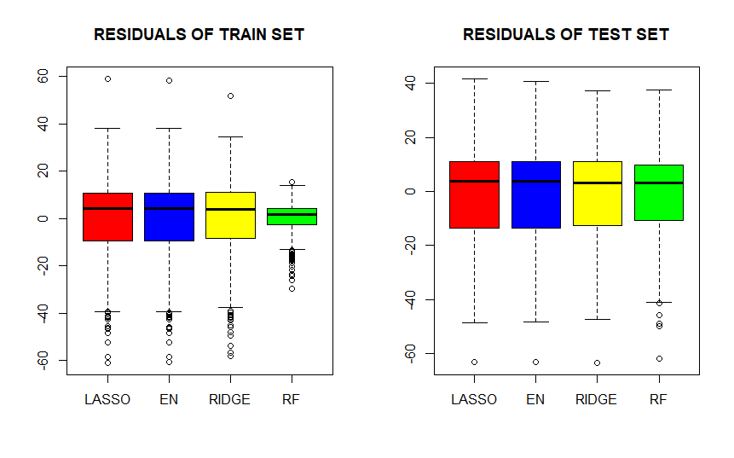
Residuals

Slide 6
Confidence Interval and time
 | 90% confidence interval R^2 | time
Lasso | 0.1706,0.1860 | 0.2164s
Elastic-net | 0.1688,0.1855 | 0.1695s
Ridge | 0.1688,0.1825 | 0.1287s
Random forest | 0.2539,0.2643 | 5.1871s

Slide 7
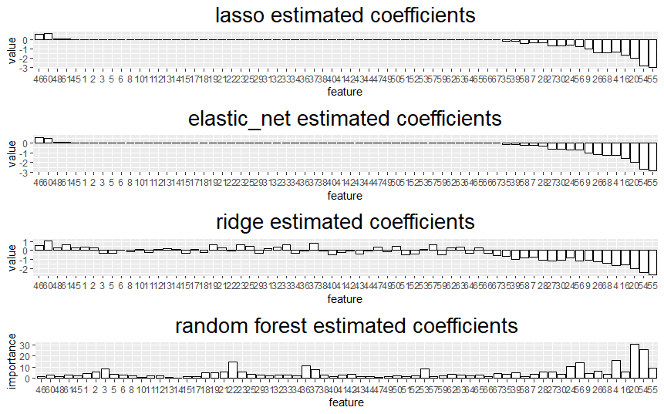
Estimated coefficients

Slide 8
Conclusion
The linear models didn’t fit the data well.
Lasso and elastic-net performed almost the same.
The random forest had the best performance but took time.
Next step: enlarge the sample size

